Slide 1
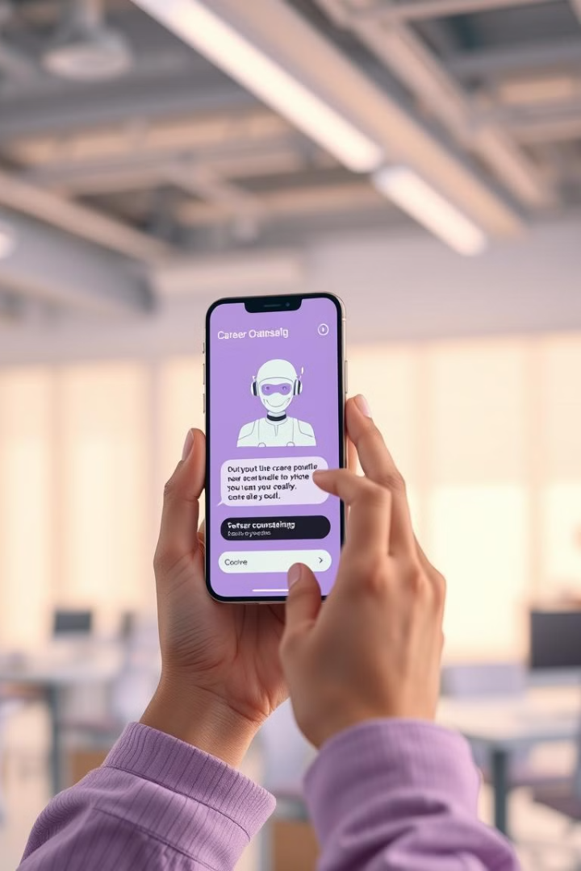

AI-Powered Career Guidance: The Future of Career Counseling
Imagine a world where personalized career advice is always available at your fingertips. This is the promise of AI-powered career counseling chatbots, revolutionizing the way we navigate our professional journeys.

Slide 2
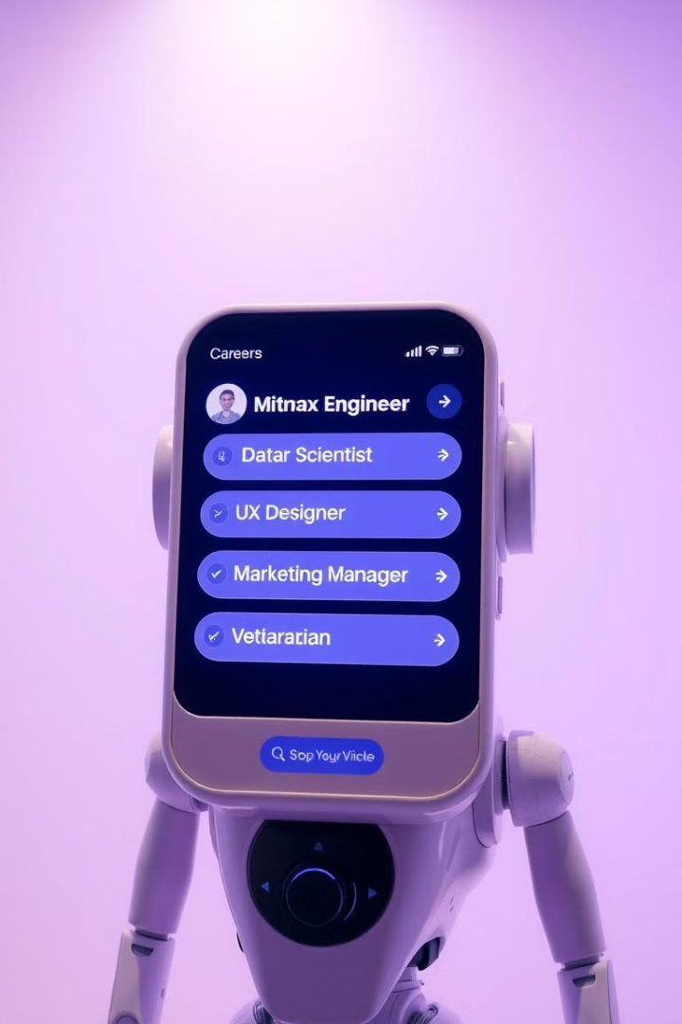
Personalized Career Guidance
1
Tailored Recommendations
2
Personalized Insights
Chatbots analyze your interests, skills, and experience to suggest suitable career paths.
AI algorithms provide detailed information about various professions, including salary expectations and job outlook.
3
Career Path Exploration
Chatbots offer interactive tools to help you visualize different career trajectories and explore potential growth opportunities.

Slide 3
Seamless Integration with Google
Leveraging Google's Resources
Google Search Integration
Google Assistant Compatibility
Seamless integration with Google Search enables users to quickly find relevant information about specific careers or industries.
Chatbots can access Google's vast knowledge base, including job listings, industry data, and educational resources.
Users can access career guidance via voice commands, making it convenient to seek advice on the go.

Slide 4
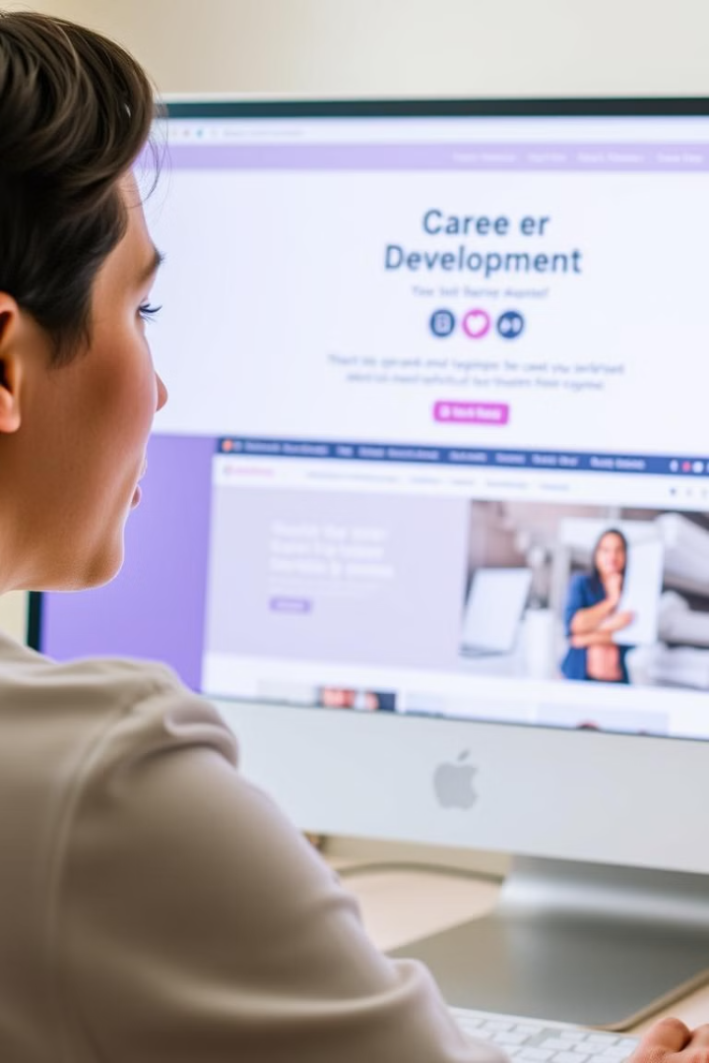
Enhanced Career Exploration
1
Skills Assessment
Chatbots conduct interactive assessments to identify your strengths and areas for improvement.
2
Job Market Analysis
AI algorithms analyze current job trends and provide insights into the demand for specific skills.
3
Personalized Learning Paths
Chatbots recommend educational programs, certifications, and training opportunities based on your career goals.

Slide 5

Efficient and Accessible Guidance
24/7 Availability
Cost-Effective Solution
Increased Accessibility
Chatbots provide instant access to career guidance whenever you need it, regardless of time or location.
AI-powered chatbots offer an affordable alternative to traditional career counseling services.
Chatbots break down geographical barriers, making career guidance accessible to a wider audience.

Slide 6




The Future of Career Guidance
AI-Driven Personalization
AI will continue to evolve, offering even more personalized and tailored career guidance.
Integration with Job Platforms
Chatbots will seamlessly connect users with job opportunities, simplifying the job search process.
Enhanced Career Coaching
AI will provide more interactive and engaging career coaching experiences, fostering personal growth and professional development.

Slide 7
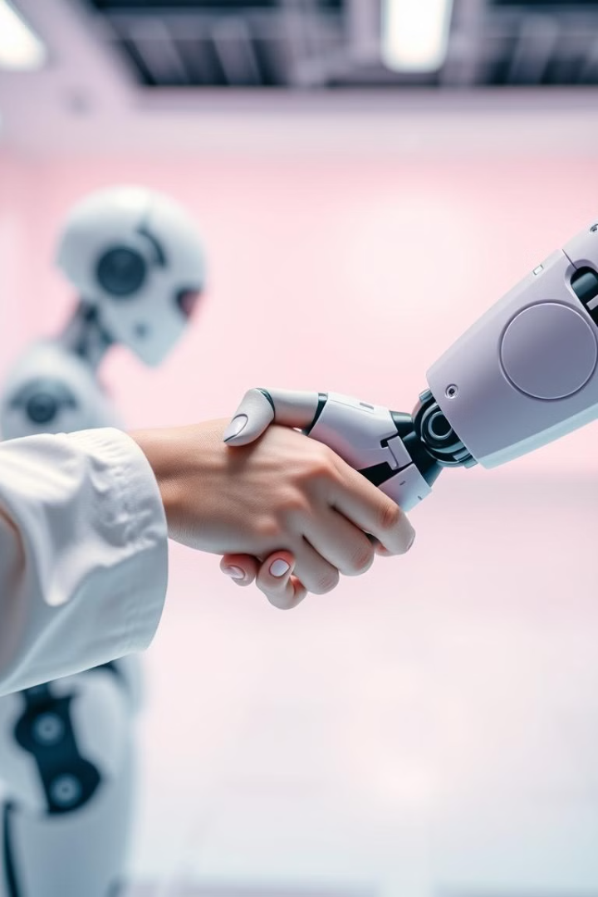
Conclusion: A New Era of Career Empowerment
AI-powered career counseling chatbots are transforming the landscape of career guidance. By providing personalized insights, efficient services, and accessible support, they are empowering individuals to make informed decisions about their future.

Slide 8
THANKYOU
DONE BY :
HARSHINI R (22CS031)
JANANI J (22CS034)
MOHANA PRASATH G (22CS050)
SHARMILA B (22CS088)

